Slide 1
8051- TIMERS

Slide 2
8051- TIMERS
The 8051 has two timers/counters : Timer 0 and Timer 1.
They can be used either as Timers to generate a time delay
or as Event counters to count events happening outside the
microcontroller
Both Timer 0 and Timer 1 are 16 bits wide.
Since 8051 has an 8-bit architecture, each 16-bit timer is accessed as two separate registers of low byte and high byte.
16-bit Register is accessed as low byte and high byte
The low byte register is called TL0/TL1 and
The high byte register is called TH0/TH1

Slide 3
8051- TIMERS cont’d…
They are accessed like any other register.
MOV TL0,#4FH
MOV R5,TH0

Slide 4
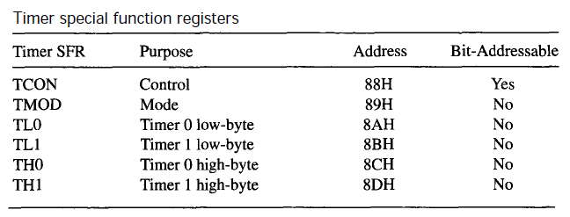
8051- TIMER Registers

Slide 5
TMOD register
Used to set the various timer operation modes
Mode 0 : 13-bit Timer Mode
Mode 1 : 16-bit Timer Mode
Mode 2 : 8-bit Auto Reload Mode
Mode 3 : Split timer Mode. (TL0, TH0 work independently. So separate clocks are required for both TL0, TH0 )
Both timers 0 and 1 use the same register, called TMOD (timer mode).
TMOD is a 8-bit register
The lower 4 bits are for Timer 0
The upper 4 bits are for Timer 1
In each case,
The lower 2 bits are used to set the timer mode
The upper 2 bits to specify the operation

Slide 6
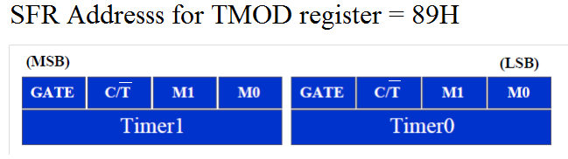
TMOD register cont’d…
GATE is used for switching the CLOCK counting.
If GATE =1 :
Counting can be initiated by both software and hard ware interrupts.
If GATE =0 :
Counting can be initiated by only software interrupts.

Slide 7
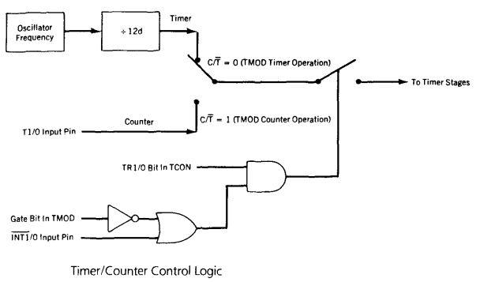
Timer/ Counter control Logic
1 ; iff TR=1 in TCON
0
1
1
If GATE =0 :
Counting can be initiated by only software interrupts (TR 1/0 bit in TCON).

Slide 8
Timer/ Counter control Logic
S/W
1 ; iff TR=1 in TCON
* TR→ Timer Run control
1
0
1 ; iff
H/W
If GATE =1 :
Counting can be initiated by both software and hard ware interrupts.

Slide 9
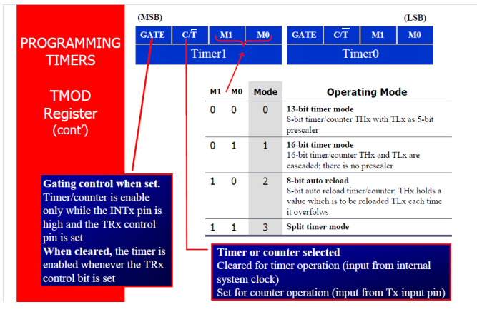
TMOD register cont’d…

Slide 10
TMOD register cont’d…
Pulse
input
TLX 5 bits
THX 8 bits
TFX
Interrupts
Timer Mode 0 : 13 bit Timer / Counter
Pulse
input
TLX 8 bits
THX 8 bits
TFX
Interrupts
Timer Mode 1 : 16 bit Timer / Counter

Slide 11
TMOD register cont’d…
Timer Mode 2 : 8 bit Auto Reload of TL from TH
Pulse
input
TLX 8 bits
TFX
Interrupts
THX 8 bits
The timer low-byte (TLx) operates as an 8-bit timer, while the timer high-byte
(THx) holds a reload value.
When the count overflows from 0FFH, not only is the timer flag set, but the
value in THx is loaded into TLx; counting continues from this value up to
the next 0FFH overflow, and so on.
If TLx contains 4FH, for example, the time counts continuously
from 4FH to 0FFH.

Slide 12
TMOD register cont’d…
Timer Mode 3 : Split Timer Mode
Pulse
input
TL0 8 bits
TF0
Interrupts
f/12
TH0 8 bits
TF1
Interrupts
TR 1 bit
in TCON
Mode 3 is the split timer mode and is different for each timer.
Timer 0 in mode 3 is split into two 8-bit timers.
TL0 and TH0 act as separate timers with overflows setting the
TF0 and TF1 bits, respectively.
Timer 1 is stopped in mode 3.
Limitation:
Timer 1 overflow flag, TF1, is not affected by Timer 1 overflows,
since it is connected to TH0.

Slide 13
TCON- Timer Control Register

Slide 14
TCON Register
TF 1 | TR 1 | TF 0 | TR 0 | IE 1 | IT 1 | IE 0 | IT 0
TF 1 : Timer 1 overflow flag
TR 1 : Timer 1 run control bit to set the timer 1 as ON/OFF
TF 0 : Timer 0 overflow flag
TR 0 : Timer 0 run control bit to set the timer 0 as ON/OFF
IE 1 : External Interrupt 1, edge flag
IT 1: Interrupt type 1 control bit: to specify falling edge
IE 0 : External Interrupt 0, edge flag
IT 0: Interrupt type 0 control bit: to specify falling edge .

